Slide 1

CS47: Cross-Platform Mobile Development
Lecture 3A: User-Interactive Components (TextInput + Lists)
Faculty Advisor
Instructor #1
Fall 2019
https://class.website
class.slack.com

Slide 2

Live Demo
Jedi ID Card List
Run cd SectionList
Run npm install
Open with Expo

Slide 3

Overview for today
Functional Components (from last lecture)
Live demos (throughout lecture)
TextInput
ScrollView
Lists
Flatlist
SectionList
Advanced: Infinite Scroll
Notes:
Flexbox: recap from last lecture.

Slide 4
Functional Component
A Component that is declared like a JS function.

Slide 5
Functional Component
A Component that is declared like a JS function.
const App = () => {
return ( <View style={styles.container}> <Text>Hello World!</Text> </View>
);
}

Slide 6
Functional Component
A Component that is declared like a JS function.
const App = (greeting) => {
return ( <View style={styles.container}> <Text>{greeting}</Text> </View>
);
}
Notes:
Since it is a function, you can pass in variables like you would to a normal function. This is equivalent to passing a prop into a class component.
What if we wanted to make a functional component interactive too? Until recently, we weren’t able to because there was no state in functional components. Then, React introduced a way to apply the state feature to functional components.

Slide 7
Hooks
Functions that allow you to “hook into” React state and life cycle features from function components.
Notes:
We’ll talk about component life cycles later in the course.

Slide 8
Hooks
Functions that allow you to “hook into” React state and life cycle features from function components.
Two Rules of Hooks
1) Only call Hooks at the top level
2) Only call Hooks from React
functional components
Notes:
Only call Hooks at the top level. Don’t call Hooks inside loops, conditions, or nested functions.
Only call Hooks from React function components. Don’t call Hooks from regular JavaScript functions.
There are a few built-in hooks already provided by React, but for now we will just look at one: useState.

Slide 9
state object
(Class Components)
useState Hook
(Functional Components)
const [x, setX] = useState(z)
setX(y)
import { useState } from 'react';
state = { x: z }
this.setState({ x: y })
Functional Components
Hooks
Notes:
We already know about the state object that we can use with class components, and the useState Hook is basically the same idea, but with functional components.
Array destructuring.

Slide 10
How would you change the code for our Jedi ID Card to use functional components and the useState Hook (instead of
class components and props/state)?
(We’ll leave this as a highly recommended exercise,
but the solution can be found here.)
USEFUL LINKS / React Hooks

Slide 11
Overview for today
Functional Components (from last lecture)
Live demos (throughout lecture)
TextInput
ScrollView
Lists
Flatlist
SectionList
Advanced: Infinite Scroll
Notes:
Flexbox: recap from last lecture.

Slide 12
ScrollViews
Renders all components at once
Slower performance and larger memory usage
Need to bind the height or it renders wonky

Slide 13
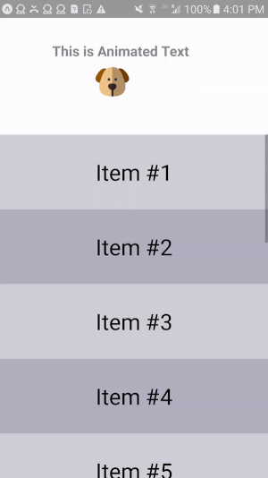
ScrollViews
Renders all components at once
Slower performance and larger memory usage
Need to bind the height or it renders wonky

Slide 14
FlatLists and SectionLists
Both
Fully Cross-Platform
Header/Footer Support
Pull to Refresh
Horizontal Scrolling
Column Support
https://facebook.github.io/react-native/blog/2017/03/13/better-list-views

Slide 15
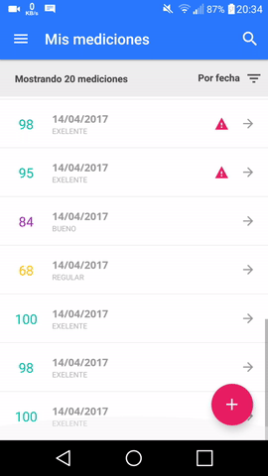
FlatLists
Simpler Lists
You just need an array and a renderItem Function
“Workhorse”
Capable of more complicated things, but sectionLists are better equipped for that
https://facebook.github.io/react-native/docs/flatlist

Slide 16
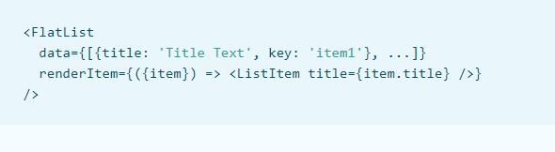
FlatLists

Slide 17
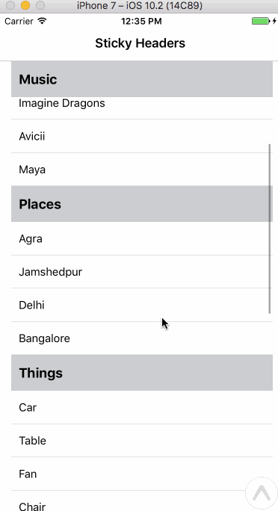
SectionLists
More Complex Lists (Section Support)
Section Header/Separator Support
Heterogenous data/item rendering support
https://facebook.github.io/react-native/docs/sectionlist

Slide 18
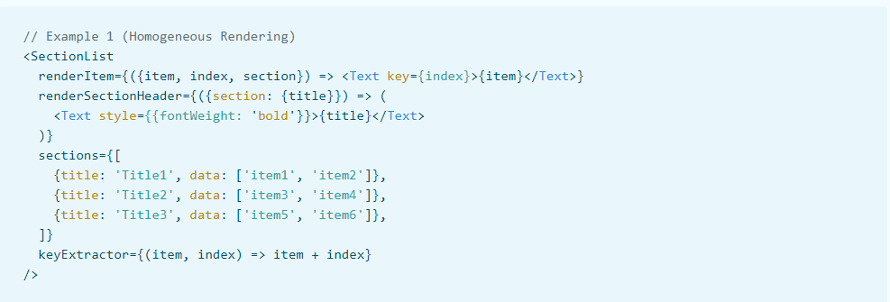
SectionLists

Slide 19
TextInputs
Simple Component
Multiline Support
Can Set Placeholders
https://facebook.github.io/react-native/docs/textinput

Slide 20

Demos
Live demo
Introduce ScrollView.
Introduce FlatList and SectionList with networking.
Introduce TextInputs.

Slide 21
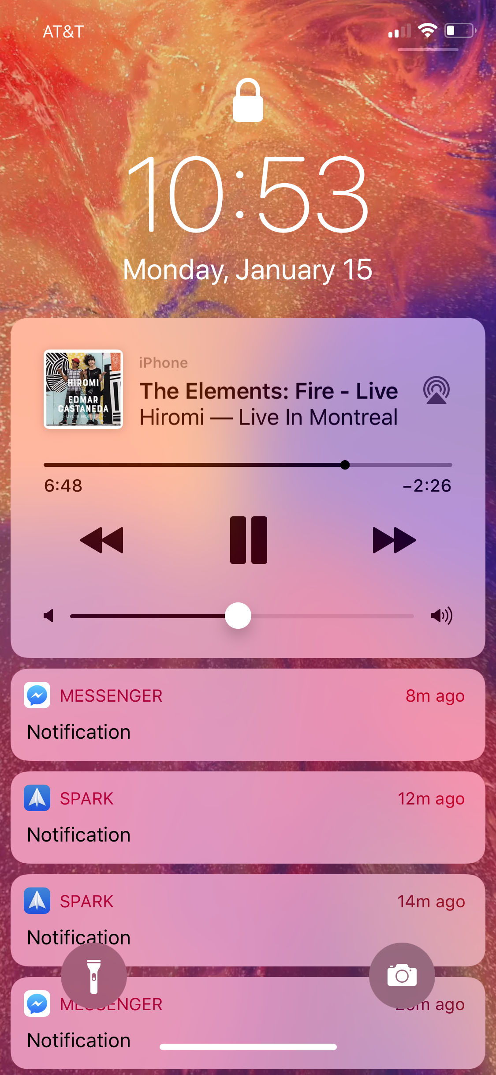
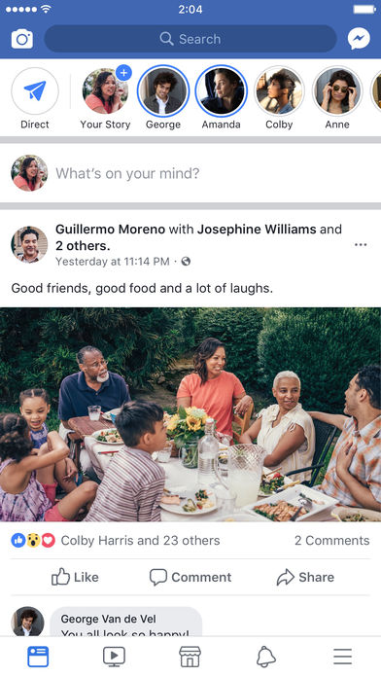

ScrollView and Lists
Notes:
Flexbox: recap from last lecture.

Slide 22
Live Demo
Jedi ID Card List

Slide 23
Live Demo
Jedi ID Card List
Run cd SectionList
Run npm install
Open with Expo

Slide 24
Live Demo
Jedi ID Card List
Create an application that has a list with:
Customized items
Sticky headers
Infinite Scrolling
Pull down to refresh
Fetches info from a server
Handles Concurrent Calls

Slide 25

Overview for today
Live demo
Introduce ScrollView.
Introduce FlatList and SectionList with networking.
Introduce TextInputs.

Slide 26

Overview for today
Live demo
Introduce ScrollView.
Introduce FlatList and SectionList with networking.
Introduce TextInputs.

Slide 27
Live Demo
Jedi ID Card Editor

Slide 28
Live Demo
Jedi ID Card Editor
Run cd CardEditor
Run npm install
Open with Expo

Slide 29
Live Demo
Jedi ID Card Editor
Create an application that can take custom input for the values of the jedi card

Slide 30
CS47: Cross-Platform Mobile Development
Lecture 3A: User-Interactive Components (TextInput + Lists)
Faculty Advisor
Instructor #1
Fall 2019
https://class.website
class.slack.com

